Slide 1
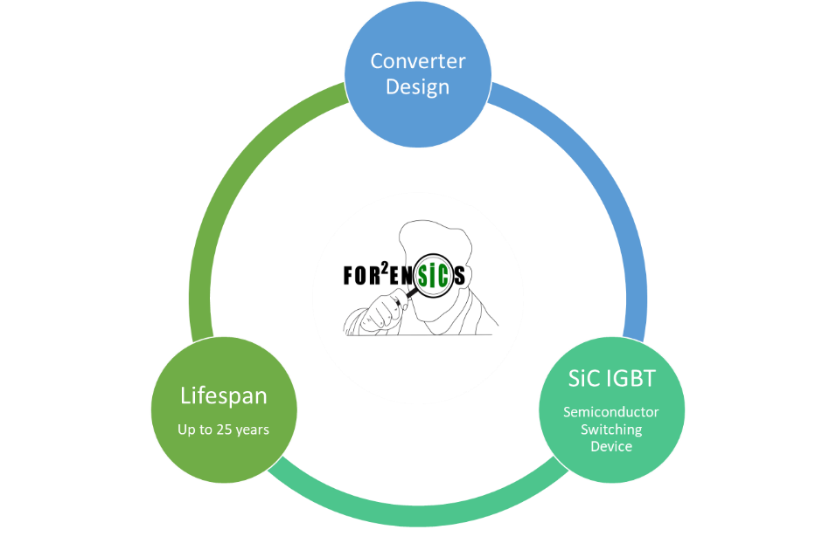
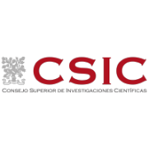
FUTURE ORIENTED RENEWABLE AND RELIABLE ENERGY SIC SOLUTIONS
This project has received funding from the European Union’s Horizon Europe research and innovation programme under grant agreement No 101075672
Commercial DC/DC converter
Ultra-high voltage (UHV) SiC based switching devices
Cost and environmental impact reduction of the fabrication processes.
Understand reliability issues

Slide 2
Commercial DC/DC converter.
Ultra-high voltage (UHV) SiC based switching devices.
Cost and environmental impact reduction of the fabrication processes.
Understand reliability issues.
FUTURE ORIENTED RENEWABLE AND RELIABLE ENERGY SIC SOLUTIONS
Grant agreement
N.101075672
https://for2ensics.imb-cnm.csic.es/

